Slide 1
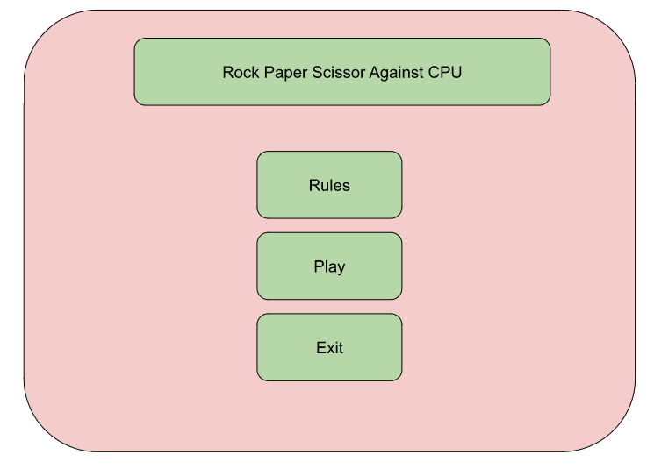
There are three buttons: Rules, Play, and Exit.
Rules will take you to the rule page, play with open up the camera and getting ready for the game, and Exit will exit the page

Slide 2
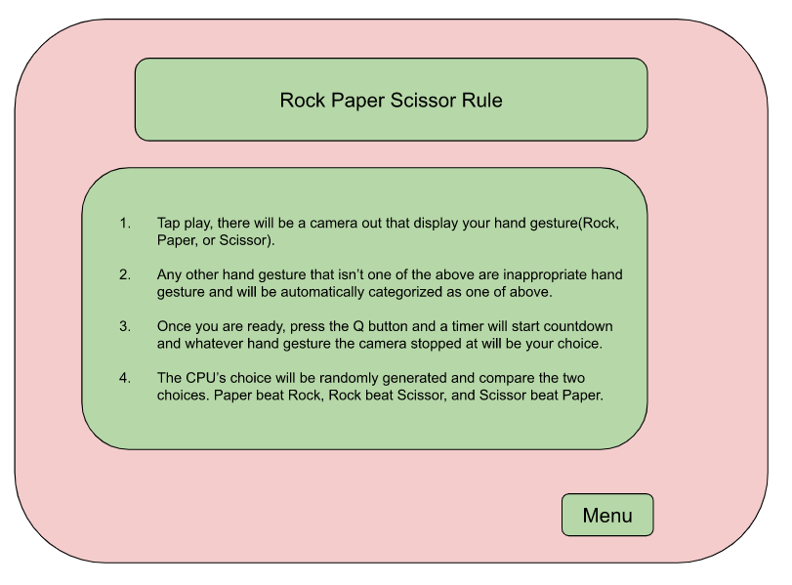
This the the rule page that explain the rules
Rule such as no inappropriate hand gesture and the hand gesture will be what the camera stopped at once timer ends
Then it will tell the result of the winner.
There is also a button going back to menu.

Slide 3
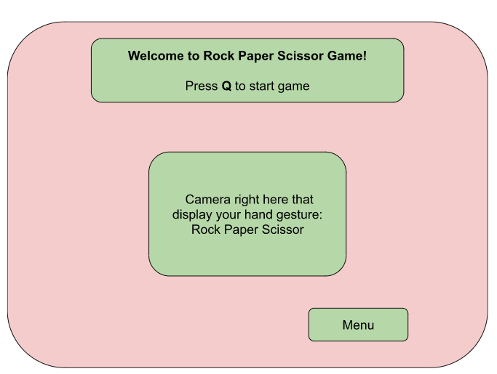
The title will tell the player to press Q to start game. The timer will start and then it will take the player to the result page.
Camera will display the hand gesture.
Another button if player wish to go back to the main menu.

Slide 4
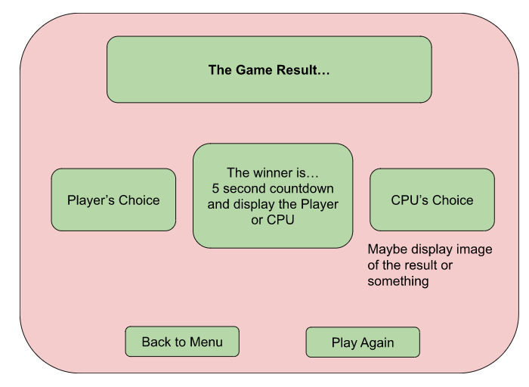
This is the game result page, it will display player and CPU’s Rock Paper Scissor choice and the winner.
There are only two buttons on this page, back to menu and play again.

